Slide 1
CLONORCHIS SINENSIS (Cobbold, 1875) Looss, 1907
DR SOWMYA R.S.G
DEPT OF PATHOLOGY AND MICROBIOLOGY
SKHMC

Slide 2
Taxonomy :
Kingdom : Animalia
Phylum : Platyhelminthes
Class : Trematoda
Order : Opisthorchiida
Family : Opisthorchiidae
Genus : Clonorchis
Species : C. sinensis

Slide 3
Introduction
“Oriental Liver Fluke”/ The Chinese l iver Fluke
Food born parasite
An estimated 30 million people are infected with C. sinensis.
The parasite may live up to 45 years in humans.
Clonorchis means branched Testes

Slide 4
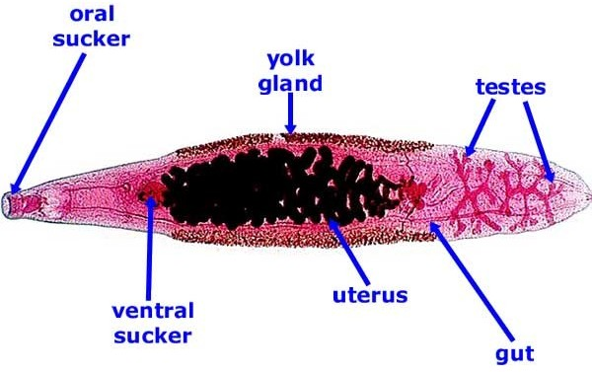

Slide 5
Morphology
Adult worm
Flat, elongated worm, narrow with the size 10-25 15×3-5 mm. They are monocious, with two suckers.
The Oral Suckers is slightly larger than the Ventral Suckers
The most characteristic feature is branched testis in the posterior third of the body, and relative small ovary before them

Slide 6
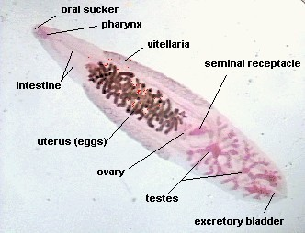

Slide 7
Morphology (eggs)
Small, 26-30 x 15-17 um
Ovoid, yellowish color
Operculated at one end, small knob at opposite end

Slide 8
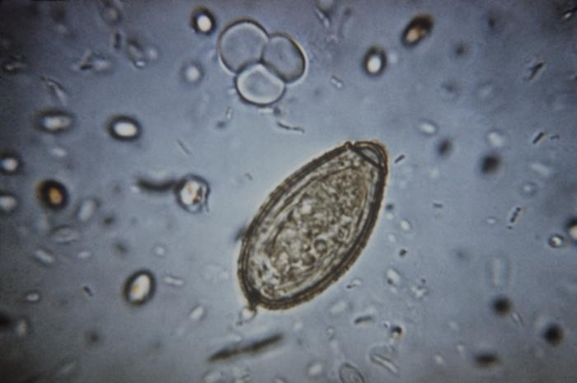

Slide 9
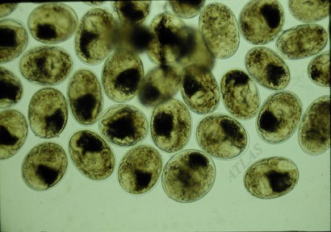
Metacercariae of Clonorchis sinensis collected from digested fish. The cyst wall is elliptical 0.16-0.20 mm long. Dark granules are in the bladder.

Slide 10
Geographical Distribution
A parasite of the Far East. The endemic areas include Japan, Korea, Formosa, Southern China, South Vietnam and North Vietnam. Clonorchiasis is endemic where there is poor sanitation,
First Intermediate Host : Snail
Second intermediate host : Fish (cyprinoid fish)
A population who eats raw, poorly pickled, smoked, dried or salted freshwater fish

Slide 11
Definitive Hosts
Any fish eating mammals
Humans
Humans are an incidental host, the natural definitive hosts are those that fallow in this list
Pigs
Dogs
Cats
Rats
Camels

Slide 12
Intermediate Hosts :
Snails
Fish
First intermediate host must always be a snail, mainly : B u l i m i n a e
Second intermediate host is usually a fish : (cyprinoid fish)
12 species of fish are mainly responsible for passing the infection to humans

Slide 13
Source of infection: patients, infected reservior hosts:cats, dogs, mice, pigs
Infective Agent : Metacercariae in fish flesh
Route of transmission: the infection is acquired by eating raw or inadequately cooked freshwater fish or shrimp, which are previously infected – Alimentary canal
Site of Localisation : Biliary tract of Liver
Susceptibility: human is generally susceptive, related with the dietary habits

Slide 14
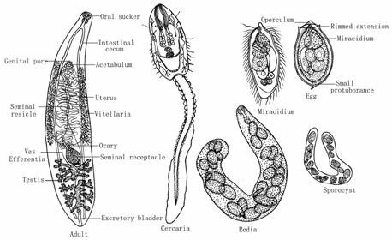

Slide 15
Life Cycle
Adults in biliary ducts, embryonated eggs pass to intestine and out with the feces
Eggs reach water, ingested by suitable snail (P. manchouricus)
In the snail (first intermediate host, eggs release miracidium and goes through several stages in host (sporocyst>rediae>cercariae)
Cercariae released from snail, free-swimming in water, penetrates under scales of an appropriate freshwater fish (second intermediate host)

Slide 16
Metacercariae encyst in the fish muscle
Humans infected by eating raw, partially cooked, smoked or pickled fish
Metacercariae excysts in the duodenum
Ascends up through intestine to bile ducts
Matures to adult in 30 days
Worms may live 30-40 years in final host
Carnivorous animals can serve as reservoir hosts

Slide 17
Pathogenesis
Clonorchiasis is the disease caused by Clonochis sinensis
Worms mechanical stimulation proliferate inflammatory reaction in the biliary epithelium
The wall of the bile ducts thickened ,fibrous tissue around the bile duct, and worm obstruction cause cholestasis
When bacteria infection occur, cause cholecystitis, cholangeitis, sometimes cholelithiasis happens

Slide 18
Pathology
Intrahepatic bile ducts expansion, hepatomegaly, necrosis of liver tissue
Continuous severe infection may cause liver cirrhosis
Persistent Cholestasis cause biliary liver cirrhosis
Associate with cholangiocarcinoma and hepatic carcinoma

Slide 19
Clinical Manifestation
Acute symptoms appear when the primary infection is heavy: sudden onset, chill, high fever, slight jaundice, hepatomegaly, eosinophilia, a few patients have splenomegaly, and weeks later, enter chronic stage
Continuous re-infection: cirrhosis and portal hypertension. In children may cause malnutrition growth development disturbance, even dwarf

Slide 20
Complications
Acute or chronic cholecystitis, cholangeitis and cholelithiasis are the most common complications
Portal liver cirrhosis: portal hepertension result in upper gastrointestinal bleeding
Cholestatic cirrhosis
Pancreatitis
Primary carcinoma of the liver and cholangiocarcinoma

Slide 21
Diagnosis
Laboratory findings:
Discovery of characteristic eggs in feces or by duodenal aspiration come to accurate diagnosis
Eggs examination:
simple smear feces to find eggs
Stool concentration technique may increase the positive rate Duodenal aspiration: raise the chance of finding eggs
Blood routine test: eosinophilia, anemia in severe infection
Eosinophilia and positive immunologic test support the diagnosis

Slide 22
Immunological Test
Skin test: positive rate 97.9%, 99.5% coincide with the result of the feces
PHA: positive rate 53.7%, 80% coincide with the result of the feces
ELISA: positive rate 98.3%, 93.5% coincide with the result of the feces

Slide 23
Prevention
Control of the source of infection:
Treat the patients and domestic animal(cats and dogs, etc.) at the same time.
Cut off the route of transmission:
Avoid of eating inadequately cooked freshwater fish and shrimp
Sanitary disposal of the excreta Avoid of drinking raw water

Slide 24
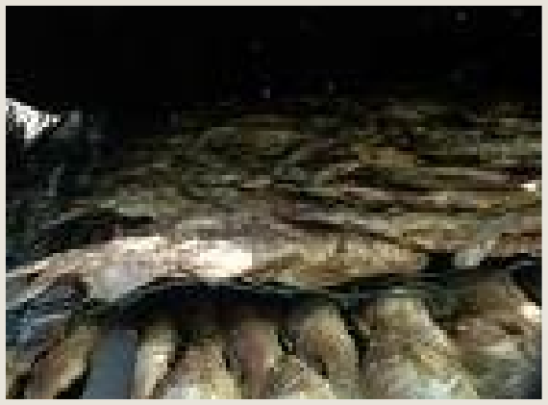
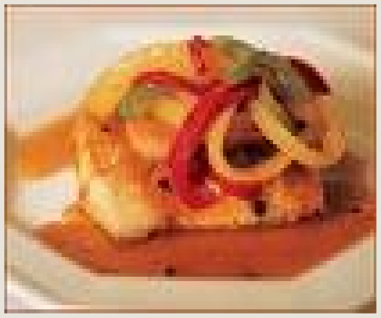
Beware!!!
Metacercariae can remain viable even after the fish has been pickled, salted, dried, or smoked

